Slide 1
Working with Smart Cards: macOS and Security

Slide 2
DISCLAIMER
I am not here representing any employer of mine, current or otherwise.
Information contained within is not specific to any employer of mine, current or otherwise.
This is a complex topic so may not transfer to your environment as-is.
Please leave Q+A until the end. If we run out of time, grab me during the conference.

Slide 3
About Me
I have worked as a IT contractor in three business sectors and three different countries since 2005. (UK, Saudi Arabia and Switzerland).
Aiming for country no.4 (USA) in 2017/18. Maybe.
Slack / JAMFNation : franton
Twitter : @richard_purves
WWW : www.richard-purves.com

Slide 4
What am I faffing on about?
A (brief) history of Smart Cards
What Apple is doing with them internally
What kind of cards exist
How to make them work with macOS
Jerry Springer’s Final Thoughts
These slides at: http://www.github.com/franton/2017-SC-Talk

Slide 5
History of Smart Cards
1887 : Edward Bellamy’s novel “Looking Backward”
First use of the term “credit card”
He used it eleven times!

Slide 6
History of Smart Cards
1968 & 1969 : Helmut Gröttrup and Jürgen Dethloff jointly file patents for the “automated chip card”
Helmut Gröttrup
Jürgen Dethloff

Slide 7
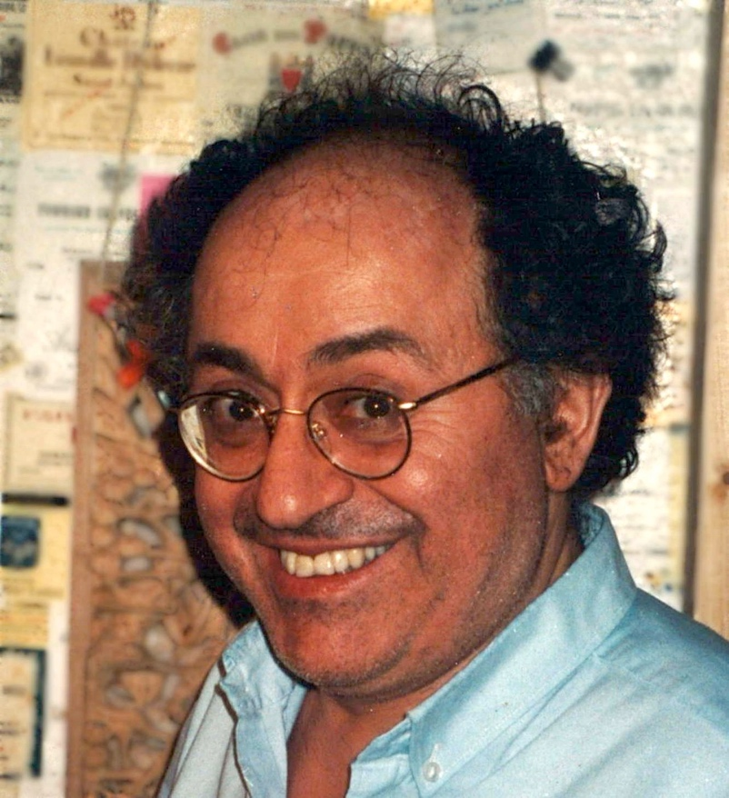
History of Smart Cards
1974 : Roland Moreno patents the “memory card” concept.
He became a French national hero and was awarded the Légion d'Honneur in 2009.
Notes:
"I can stop anyone on the street in Paris and they'll have at least three smart cards on them”

Slide 8
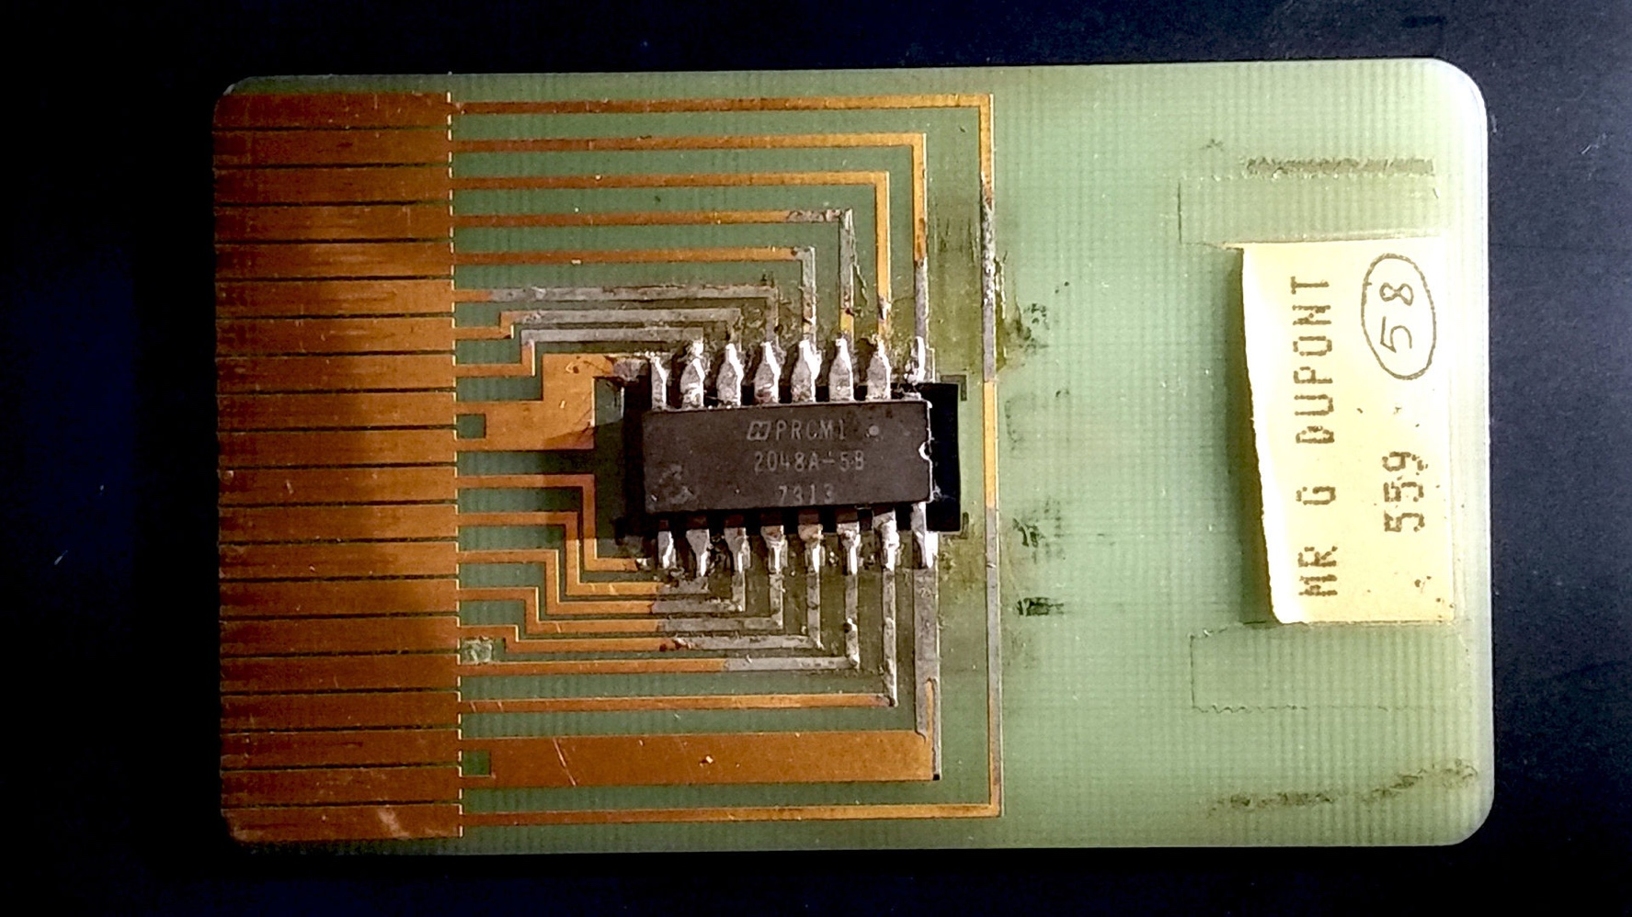
History of Smart Cards
1974 : Roland Moreno patents the “memory card” concept.
The first smart card looked like this:

Slide 9
What are Smart Cards?
Single Purpose and Multi-Purpose
What’s the difference?

Slide 10
What are Smart Cards?
Single Purpose Cards
Public Transit Systems
Notes:
Ventra – Chicago
CharlieCard – Boston
SmarTrip – D.C. Area
GoTO - Minneapolis

Slide 11
What are Smart Cards?
Single Purpose Cards
Hotel Keycards
Loyalty Cards

Slide 12
What are Smart Cards?
Single Purpose Cards
Magnetic Stripe & Contactless
Notes:
Magstripe - Visualization of magnetically stored information on a magnetic stripe card.
We can see two of the three tracks that can be present on cards

Slide 13
What are Smart Cards?
Single Purpose Cards
Just contains some identifying information
Stored on either magstripe or RFID chip
No intelligence to the cards themselves
All the processing logic is on a backend system somewhere else

Slide 14
What are Smart Cards?
Multi Purpose Cards - Examples
These are computers you do NOT control
Debit / Credit Cards
Notes:
Both magstripe and chip with rfid aerial

Slide 15
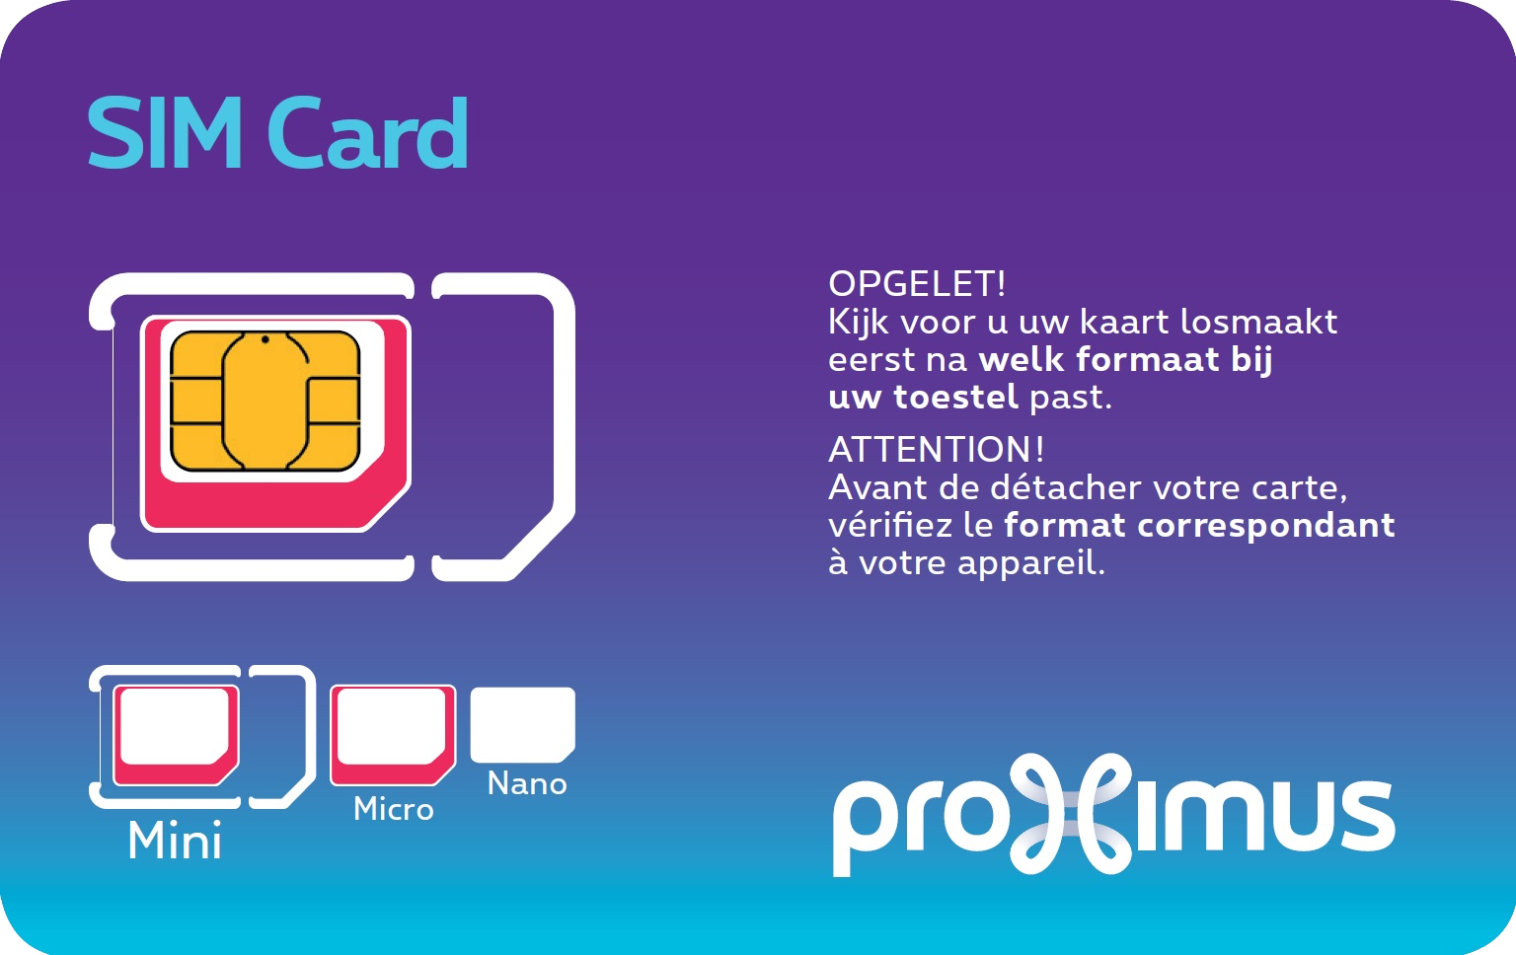
What are Smart Cards?
Multi Purpose Cards - Examples
These are computers you do NOT control
Debit / Credit Cards
Subscriber Identity Module (SIM) Card

Slide 16

What are Smart Cards?
Multi Purpose Cards - Examples
These are computers you do NOT control
Debit / Credit Cards
Subscriber Identity Module (SIM) Card
Computer Cards

Slide 17
What are Smart Cards?
Multi Purpose Cards – Example Spec (SIM Card)
Atmel AT90SC25672RU Platform
8-bit CPU
256Kb ROM
72Kb EEPROM
6Kb RAM
20 – 30 MHz Clock
Up to 500,000 erase/write cycles
They do not need lots of compute power.
As a result, they’re extremely power efficient.

Slide 18
What are Smart Cards?
Multi Purpose Cards – Operating Systems
JavaCard
It’s Java! It’s now all Oracle’s fault!
Portable. Mostly.
Mostly used in phone SIM cards
MULTOS
Multi-Application Smart Card Operating System
Overseen by the MULTOS Consortium
Mostly used by financial services companies.
.NET
Made by Gemalto
Integrates Microsoft’s .NET framework onto a card.
Notes:
JavaCard. No chars, no strings, no floats, no multi-dimensional arrays. Ints optional. No standard API, no threads.
Multos. Finding out more would involve installing Flash Player. Yuck.
Not an exhaustive list.

Slide 19
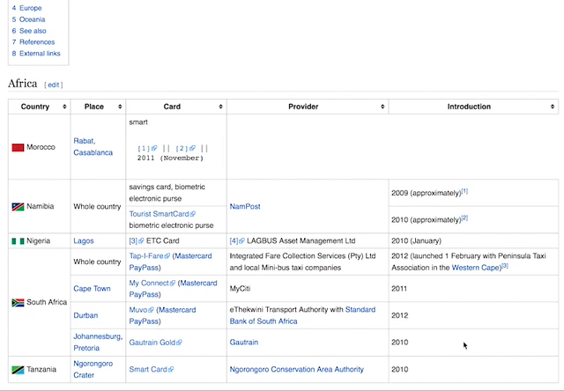
Smart Card Examples
(with thanks to Mr. Regular of “Regular Car Reviews”)

Slide 20
Apple Security Primer
Apple started back in 10.4 to use the following standards:
Common Data Security Architecture (CDSA)
Personal Computer / Smart Card (PC/SC)
Sat on macosxforge as open source until September 2016.
Now on GitHub instead
http://smartcardservices.github.io

Slide 21
Apple Security Primer
The old standards comprised of three working parts:
Smart Card Services
OS framework that everything sits in ( CDSA & PC/SC )
Smart Card CCID
The USB card reader drivers
TokenD
Low level module to communicate with the card
Apple marked the previous API’s and technologies in OS X as depreciated since 10.7

Slide 22
Apple Security Primer
Did anyone see the iOS security talk at BlackHat 2016?
Apple publicly revealed they use Smart Cards internally
Explains why 10.12 ships with a new CryptoTokenKit API that replaces the depreciated CDSA and PC/SC work.
Three “admin” cards are created for setting up a new “Cloud Key Vault” for iCloud.

